Slide 1

Mushroom Forecasting
Solution towards automated mushroom forecast

Slide 2
Areas to cover
What Forecasting is and why it is important
How humen do forecasting in LMF
Responsible visual features
Probable i/p and o/p of an automated forecasting framework
Idea of Automated Forecasting
System expection and solution
Bridging human experience with machine perseption

Slide 3
Forecasting
Forecasting is making prediction with past and present data. In mushroom forecasting time is important as a mushroom can grow in double in size within just 24 hours. Also, data is vital as forecasting is done based on most current data available.
In LMF forecast is done at the beginning of harvesting routine. Based on this forecast, team leaders decide what the best sizes would be to pick by the pickers, so harvesting is linked up with forecasting.
Forecasting is important as the farm can estimate daily net production from a tunnel and this estimation helps the farm visualise whether they will over or under hit their set target for the day.
Daily forecast is termed as estimation which is compared to actual figure. The difference helps do next day's forecast go even better with an aim to achieve actual > estimated

Slide 4

Mushroom forecasting in LMF
LMF forecast is concerned about net weight of harvested mushroom at the end of the day. Generally actual harvested figure is more than estimated figure what is forecasted. Excess mushrooms go into cold storage and are used when net harvest is lower than set production target this leads to low yield. Forecasters use their gained experience over years to forecast what tunnel will produce what amount of mushroom. They take decision over suitable size to pick, required number of pickers and their position in a tunnel
The team leader goes into tunnels before pickers enter the same. They decide the size to be picked (based on maximum likelihood of mushroom size and weight of mushroom taking out some mushrooms from clusters to finalize the decision process) and do forecasting (same factors involved: sample mushroom size and weight are priorly considered).In case of low yield happens, they cannot do much to improve it apart from doing air circulation and temperature regulation, alongside sending good pickers.

Slide 5






Key features
Big and compact clusters (visual perception) lead to high yield- number of clusters/square meter, number of mushgrooms per cluster #Visual
No of mushrooms per square meter gives a solid idea for the amount(kg) of mushroom to be expected. The bigger the number is upper the estimation goes.#measurement
Mushrooms are heavy/light ? If the mushroom is felt heavy, the bed will yield high – roundness of cup is the clue #measurement
Caps are closed/opened ? Closed caps are a sign of heavy mushrooms.If Maximum mushrooms are closed ones, that will lead to high yield.Opened mushrooms are placed in class B. again roundness of cup is releb=vant here#visual
Round/deformed? Perfect or roundish shape yields high while deformed ones are burden to yield. Too many deformed ones in a bed will signify forecast should not be made high. #visual
Compost reacts and decays fast and if compost is not well maintained until the end of harvest it can be a cause of actual vs forecast imbalance. Compost must not be disturbed and kept at constant temperature e.g., 17°C. Growes feedback whether the compost is good or bad in quality helps forecasters in forecasting #compost state

Slide 6

Automated forecasting
Forecasting will be based on images taken from a camera and after processing those images with feature mapping mushrooms will be tagged with their harvesting time. Forecasting will be done at the beginning of harvesting routine. Given Harvester will run for 18 hours at a stretch. Forecasting will take place at hour 0 and then hour 9 considering mushroom may grow half of the size in 12 hours. Input: Image/live stream/captured video Output :
Harvest time
1. Display number of mushrooms corresponding to different sizes, given first 2 days the size is pretty much 20-35 next two days it go with 30-85 and last day >65 or >85+ if available 2. Adjust net weight on daily basis with actual data input
Yield Production
3. Net weight per tunnel in terms of Class A and B 4. size-weight graph : it will show a table having number of mushrooms classed between A and B, net weight at the end of the stream
(A particular type of mushroom grows in a particular tunnel(shelf). With help of tunnel id particular mushroom can be recognised by the system)

Slide 7
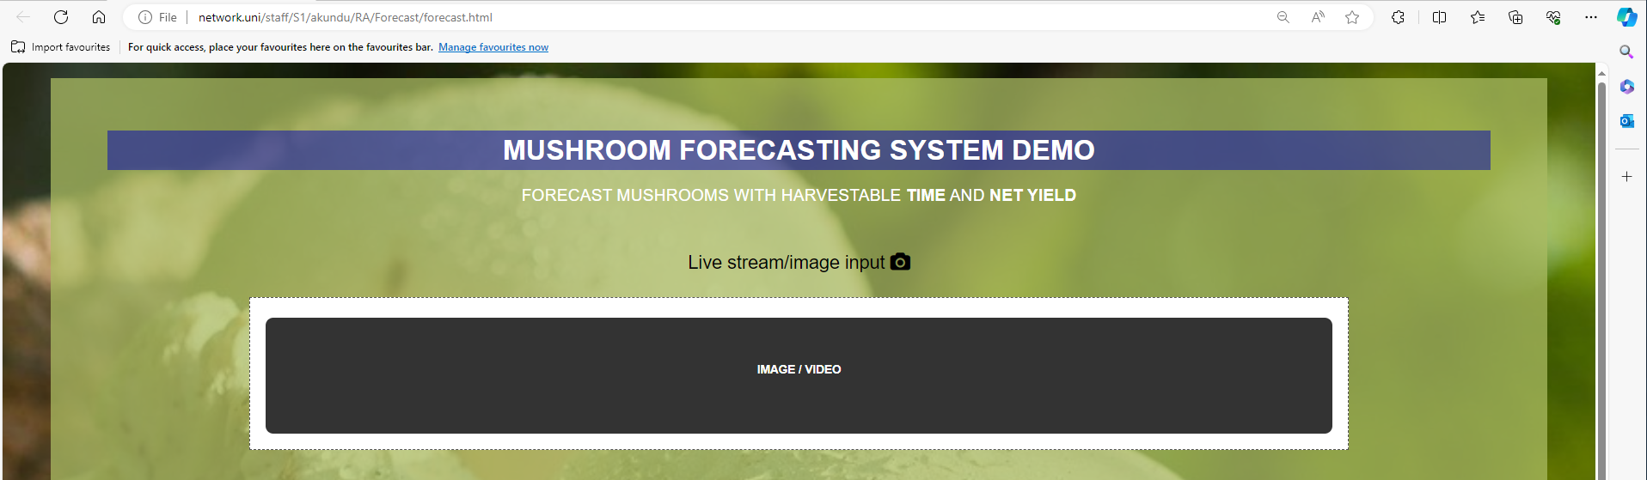
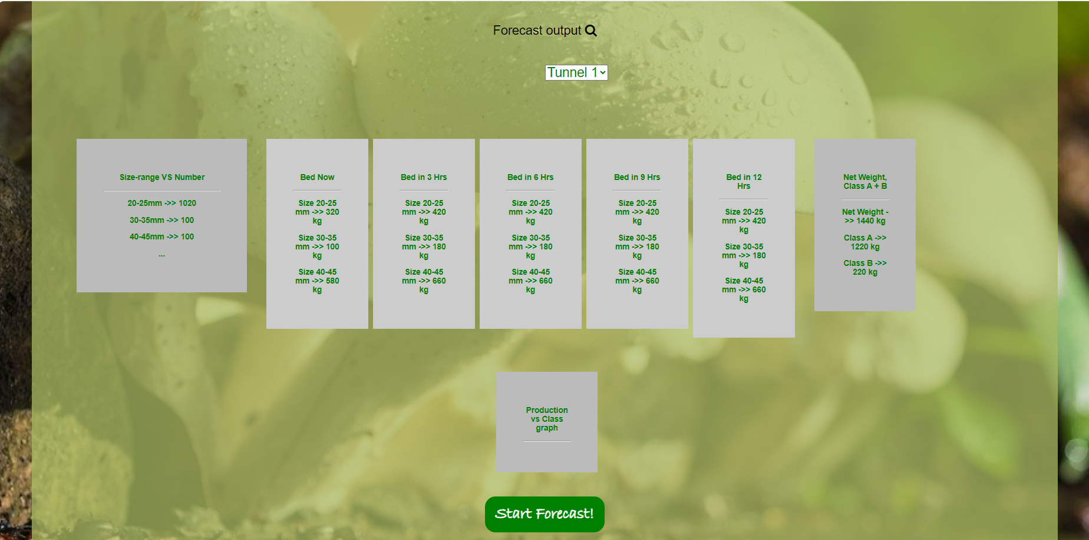
apparent I/P and O/P
link

Slide 8
Machining human forecast
This part is tricky. Not all the human perceptions leading to predict net weight are much understood to be encoded into machine perception for example how a mushroom is identified as having good weight, sometime with top view it is very challenging to see if the cap is closed or opened.If it is flat enough, it can be a sign of open cap.
With the existing algorithm in the harvester it is easy to evaluate number of mushrooms per square meter with size measurement. Therefore, with further understanding of human decision-making process based on size, weight and cluster, would be a key to mimic the seemingly challenging tasks help develop a fully-automated forecasting system.
One thing is clear, compact mushroom clusters will give rise to better yield and this feature can be encoded by computer vision calculation number of contours w.r.t cluster perimeter. Similarly with size info , apparent weight of a mushroom can be predicted. Examining same size of two mushrooms, one having low and the other one with hight weight will be worthy to consider.

Slide 9
System visualisation
Forecasting system will be an image based data mining framework what will be implemented in the harvester alongside the segmentation algorithm under forecast mode given the other mode of operation is harvest. At the beginning of forecast routine when mushrooms are detected through the camera, it will start forecasting based on the features mentioned in Key features slide. Upon full scan of a whole shelf or tunnel, it will give the user one or two best pickable size of mushroom to start harvesting with and other outputs mentioned in i/p and o/p slide for forecast.
The first step required to build such a system is to collect a load of mushroom images and build a Stat/Deep Learning model that will be trained on collected data to give outputs e.g. harvestable size, net weight per tunnel, time of harvesting etc. This data is image data that can be collected by the PE tool putting it in forecast mode where the camera will scan the whole bed the way the tool takes images. All Images from a single tunnel will be tagged with tunnel id for data representation. With data processing there would be an array of size-range with corresponding mushroom numbers. With image data and this info, forecasters will record their forecast what will help us build forecasting model

Slide 10

System expectation
For forecasting there are two main concerns: Data collection and Model building. Data can be collected during pose Estimation. We must verify if that data is sufficient for automated forecasting though. Once sufficient valid data is collected that data will be fed to a DL/stat model for building a full automated forecast system.
Existing segmentation can give better size-estimation with a little tweak. Since harvest time forecast is vital, response from forecasters will be in loop to build the system. To collect data, PE tool will run in forecast mode starting with scanning the bed. With collected image, mushroom size and number, even weight can be derived by image processing as an intermediate output alongside identifying Class A and B . With human intervention system will become robust.
As stated, earlier forecasting will be done on daily basis with what is on bed. Past data will act as a forecast-backup if sufficient features are not available on a particular day. Every day forecasted data will be stored and utilised for next day and eventually a week-long forecast. This way with time the forecast system will go better with adaptation technique. Moreover, with good picking and simultaneous forecasting-picking mushroom in time- production of class A can be made higher bringing the farm more profit
Image as input
List of Size with count +
Adapt output with human correction
Net Weight with Class A + B

Slide 11

Q/A
No Count No weigh: What needs to be picked(Sz) >Kgs How
1-2 Sep 25/30 35/45 - 55,45,35-85,65 : fixed for every session?
Pickers vs position why in Forecasting
What specification Tesco baby button 200g- Size etc? Forecast involved
Why do you forecasting and why team leaders are forecasters?
What is the input and output of your forecasting system
How forecast output is used, relevant to harvest and sell?
Special thanks to Ajay for design collaboration

Slide 12
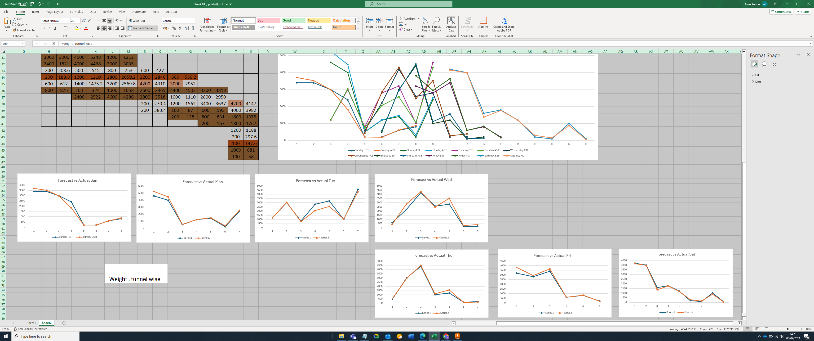
Farm's Forecast and Actual Variation @ Net weight

